Slide 1

Design and Construction of power management for effective demand response using Microcontroller
SUBMITTED BY
Your FFFFF
Reg. No. WUB 09/09/36/13e4
Your WWWW
Reg. No. WUB 09/09/36/13r4
SUPERVISED BY
Supervised By
XXXXXXXX
Lecturer, Dept. of EEE
World University of Bangladesh
‹#›

Slide 2
BACKGROUND
An electricity meter, electric energy meter is a device that measures the amount of electric energy consumed by a residence, business, or an electrically powered device. Electronic energy-meters are used for direct, small power measurements or for power measurements at frequencies beyond the range of electrodynamometer-type instruments. A modern digital electronic energymeter/energy meter samples the voltage and current thousands of times a second. For each sample, the voltage is multiplied by the current at the same instant; the average over at least one cycle is the real power.
‹#›

Slide 3
EXECUTIVE SUMMARY
The main purpose of the power meter is to measure the power by sensing voltage and current. Electric power monitor can be used to measure how much electrical energy is used at home. It measures voltage with an AC to DC adapter. The energy meter can calculate real power, apparent power, power factor, rms voltage, rms current. However, in this project real power is calculated by the Microcontroller and its corresponding energy is also calculated. All the calculations are done in the digital domain on an PIC Microcontroller. Finally, calculated value is shown on LCD. Load is controlled according to time and power using relay.
‹#›

Slide 4
OBJECTIVE
The objective is to design and construct a low cost automatic load control based on its power and time by using Microcontroller.
‹#›

Slide 5
METHODOLOGY
Collection of information from books and internet.
Electronic components have been purchased from local market.
‹#›

Slide 6
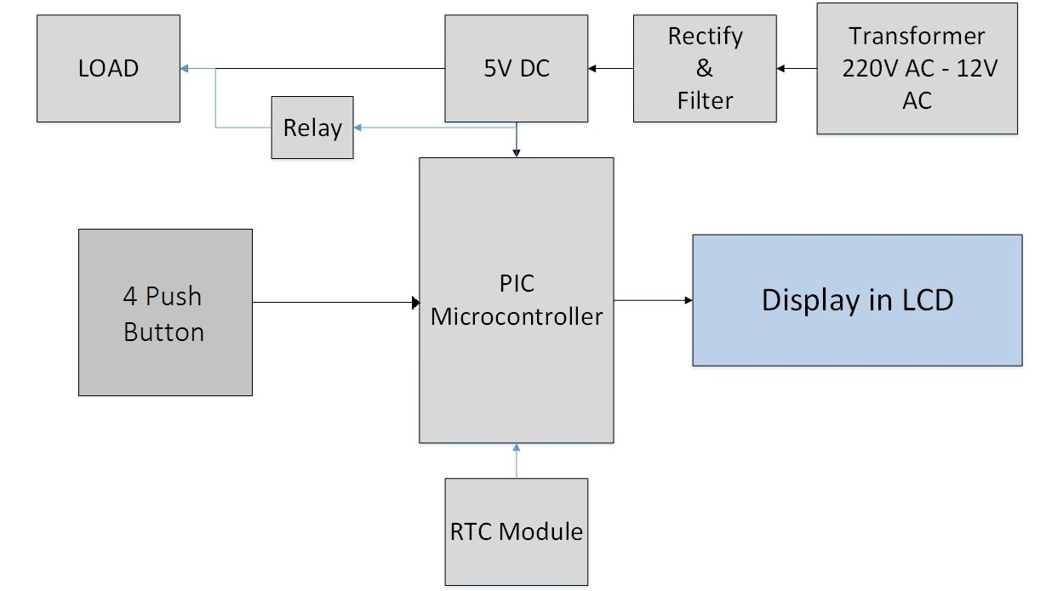
BLOCK DIAGRAM
‹#›

Slide 7
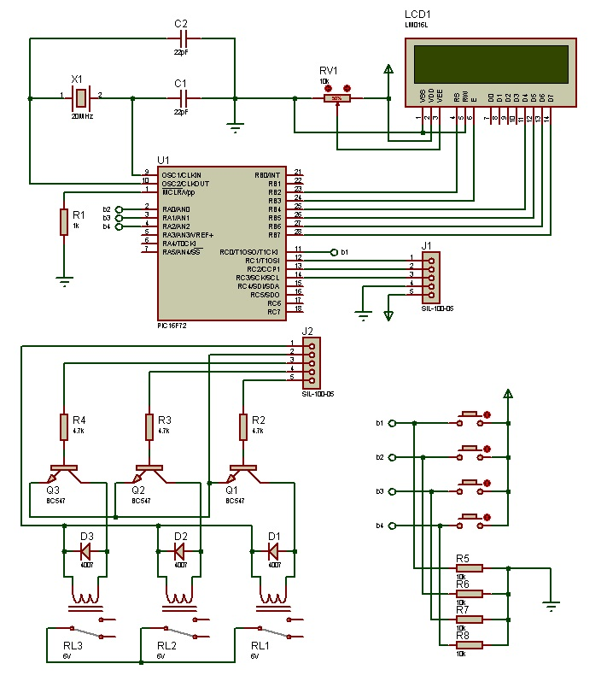
Circuit Diagram
‹#›

Slide 8
Conditions
Time | Power Consumption of Load
0.00 - 10.00 | Up to 5 Watt
10.00 - 17.00 | Up to 10 Watt
17.00 - 22.00 | Up to 15 Watt
‹#›

Slide 9
WORKING PRINCIPLE
To measure the power, it is important to measure the current and voltage from the appliance. At first, step down transformer is used to convert the voltage from 220V to 12V AC. Then this voltage is rectified and filtered before connecting to the Microcontroller because Microcontroller only works at 5V DC. After that, Voltage and Current is measured by the ADC port of the Microcontroller. Then power is calculated form the formulae P= V * I by the Microcontroller and finally result is displayed in the LCD. Also, time is calculated using RTC Module. Based on time and power, load is controlled automatically.
‹#›

Slide 10
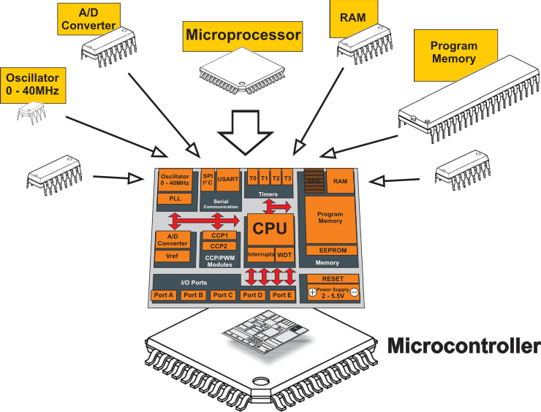
PIC MICROCONTROLLER
PIC is a family of modified Harvard architecture microcontrollers made by Microchip Technology. PIC are popular with both industrial developers and hobbyists alike due to their low cost, wide availability, large user base, extensive collection of application notes, availability of low cost or free development tools, and serial programming. In this project we have used 16C72A Microcontroller
‹#›

Slide 11
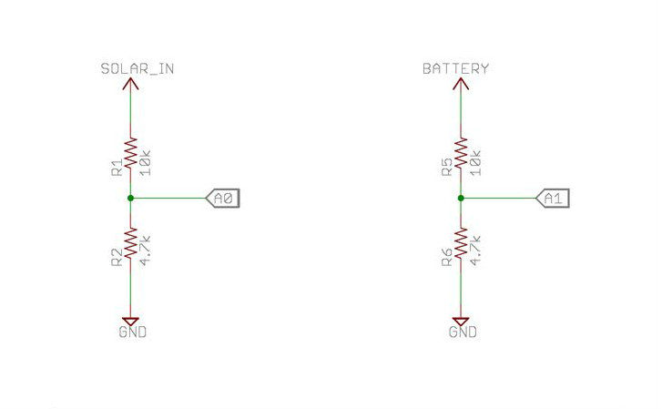
Voltage Sensing
The main sensors in the charge controller is voltage sensors which can easily implemented by using a voltage divider circuit.
‹#›

Slide 12
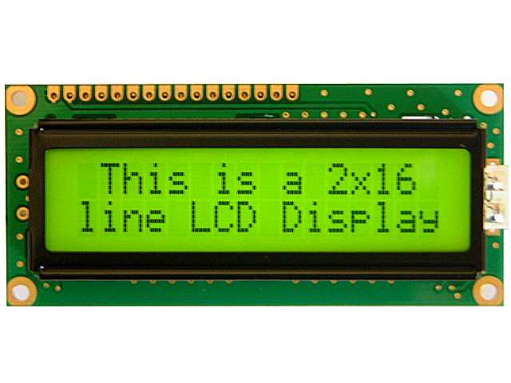
LCD(Liquid Crystal Display)
LCD (Liquid Crystal Display) screen is an electronic display module and find a wide range of applications. A 16x2 LCD display is very basic module and is very commonly used in various devices and circuits. It is available in a 16 pin package with back light, contrast adjustment function and each dot matrix has 5×8 dot resolution
‹#›

Slide 13
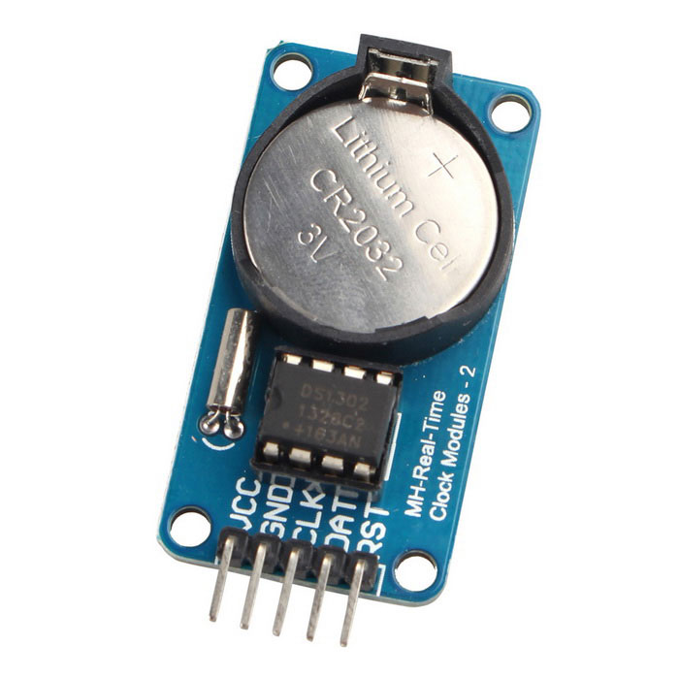
RTC Module
A real-time clock (RTC) is a computer clock that keeps track of the current time. Although the term often refers to the devices in personal computers, servers and embedded systems, RTCs are present in almost any electronic device which needs to keep accurate time.
‹#›

Slide 14
List of Components with Price
Name | Quantity | Unit Price | Total Price
Microcontroller PIC16F4550 | 1 | 200 | 200
Printed Circuit Board | 2 | 300 | 600
Transistor and Resistor | 5 | 30 | 150
Transformer | 1 | 60 | 60
Connector | 15 | 10 | 150
Capacitor, Inductor and Others | 20 | 10 | 200
LM7805, RTC | 1 | 20 | 20
LCD | 1 | 200 | 200
 |  | TOTAL COST | 1580/- Taka
 |  | Market Price | 3000/- Taka
‹#›

Slide 15
Advantages
Digital power meters are more accurate and precise.
The readings are displayed in a numerical form.
The digital power meter control load automatically according to its time and power.
‹#›

Slide 16
Applications
The digital LCD power meters can be used for domestic purposes too apart from being used for commercial purposes.
Power meter is used to measure the power consumption of an Electric circuit or an appliance which is connected to the supply.
Auto control power meter is used to save energy.
‹#›

Slide 17
DISCUSSION
To measure the power rating of the appliance first power is measured. In this project unit of power is written in Watt. The cost of digital power meter is relatively low compared to electromechanical energymeter. This energymeter is controlled by the Microcontroller which is the heart of this circuit. C language is used to program the Microcontroller. Digital power meters are more accurate and precise since the value is shown on LCD in the numerical form. Apart from using domestic purposes this digital LCD power meters
‹#›

Slide 18
DISCUSSION (Cont.)
can be used for commercial purposes as well. Finally, power meter is used to measure the power consumption of an Electric circuit or an appliance which is connected to the supply. Auto control power meter is used to save energy. This system is completely automatic and protects from excessive current. Total cost for implementing this device is 1580/- taka which is most cost effective than other system available in the market.
‹#›

Slide 19
CONCLUSION
Digital power meter is very user friendly and have higher efficiency compared to traditional electromechnical energy meter. Moreover, user can control load according to its power and time. Moreover, LCD is used for showing the real power value. In addition this device is cost effective than any other device available in the market.
‹#›

Slide 20
THANKS TO ALL
‹#›

